Slide 1
Paper Title
Author 1, Author 2, Author 3

Slide 2
Agenda
Introduction
Literature Review
Methodology
Results
Discussion
Conclusion
Future Work

Slide 3
Introduction
Welcome to ICOCO 2025!

Slide 4
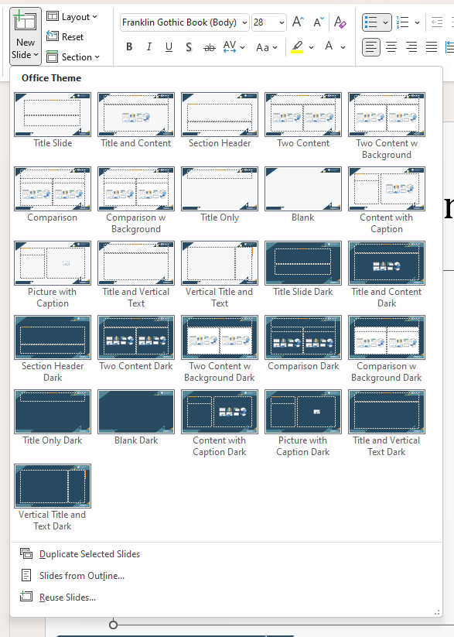
Light and Dark Themes
Go to “Home” or “Insert” tag and choose a slide design in “New Slide”.

Slide 5
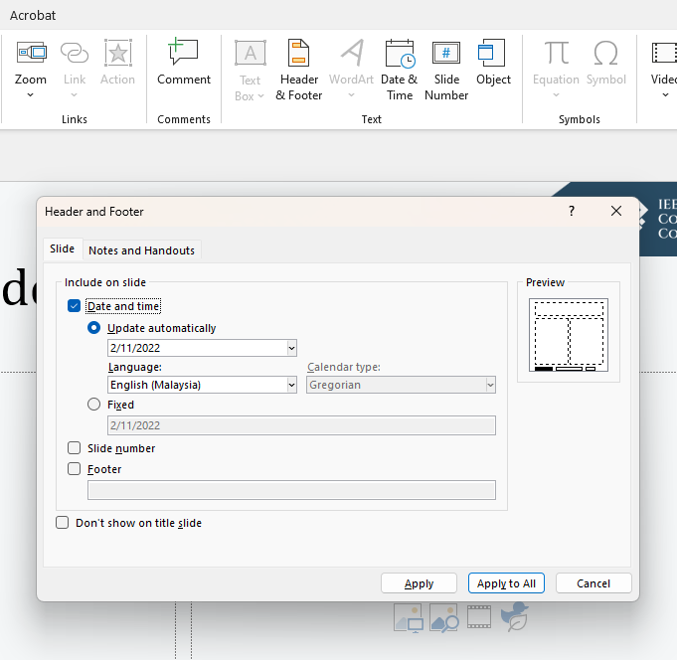
Add Date to Slides
1
Go to “Insert” tab and click “Data & Time”.
Check “Date and time” and choose “Update automatically” or “Fixed”.
Click “Apply to All” button to add date to all slides.
2
3

Slide 6
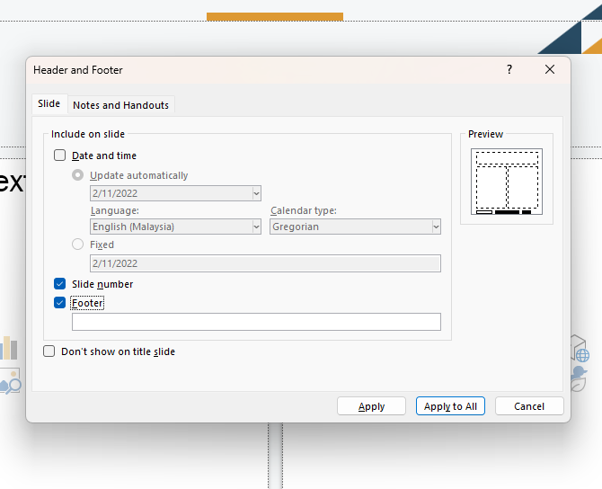
Add Footer to Slides
You can also add the slide number and footer to the slides.
Click “Apply to all” button to complete.
1
2

Slide 7






Logo ICOCO

Slide 8
Dark Theme

Slide 9
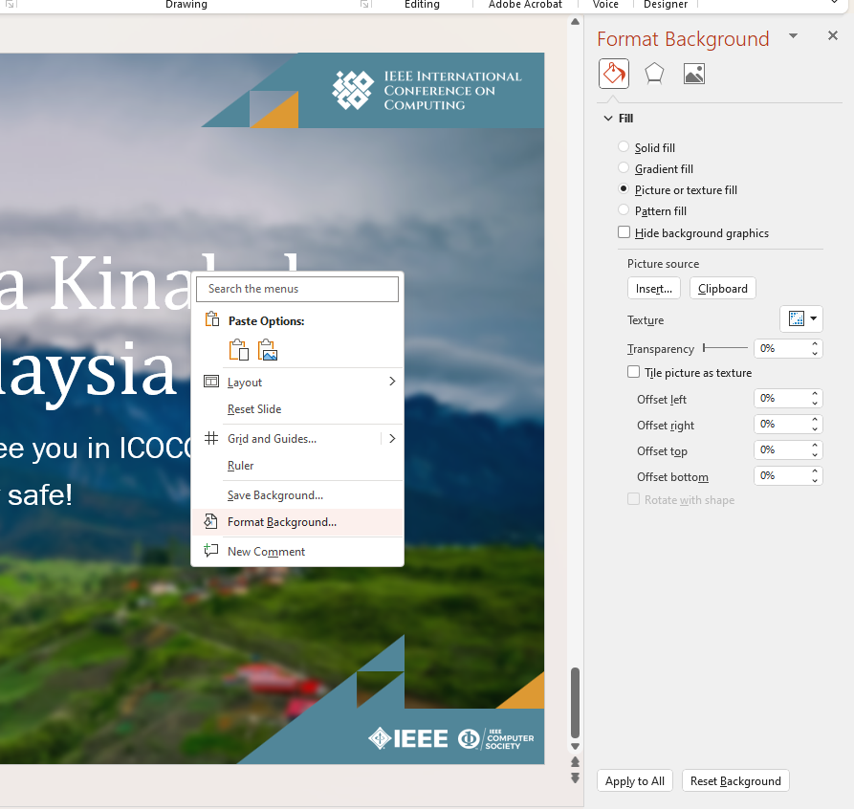
Change Background
2
For a more dramatic effect.
3
1

Slide 10
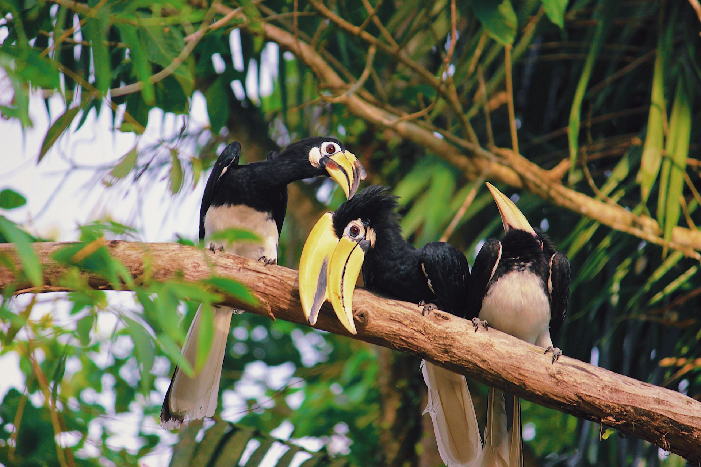
Welcome to Kuching, Malaysia
We are very happy and excited to see you in ICOCO 2025!
Take care and stay safe!

